Slide 1

HOTSPOT
Real Time Events Hot-Spot Mapping Using Twitter Feed
Single team NETID:tesfaye3

Slide 2
What it is
This is an application written in python for mapping main events across the globe.
It relies on what people across the globe tweet about.
Uses the Tweepy twitter API library to connect to the twitter server and fetch tweets.
Tweets are fetched using the search feature of the API passing date range (start and end dates for search) and search keywords.
Uses the gmplot library to draw heatmap on to google maps, uses the geopy API services to convert twitter user location to latitude longitude for gmplot’s use.
The source code is at: https://lab.textdata.org/tesfaye3/hotspot

Slide 3
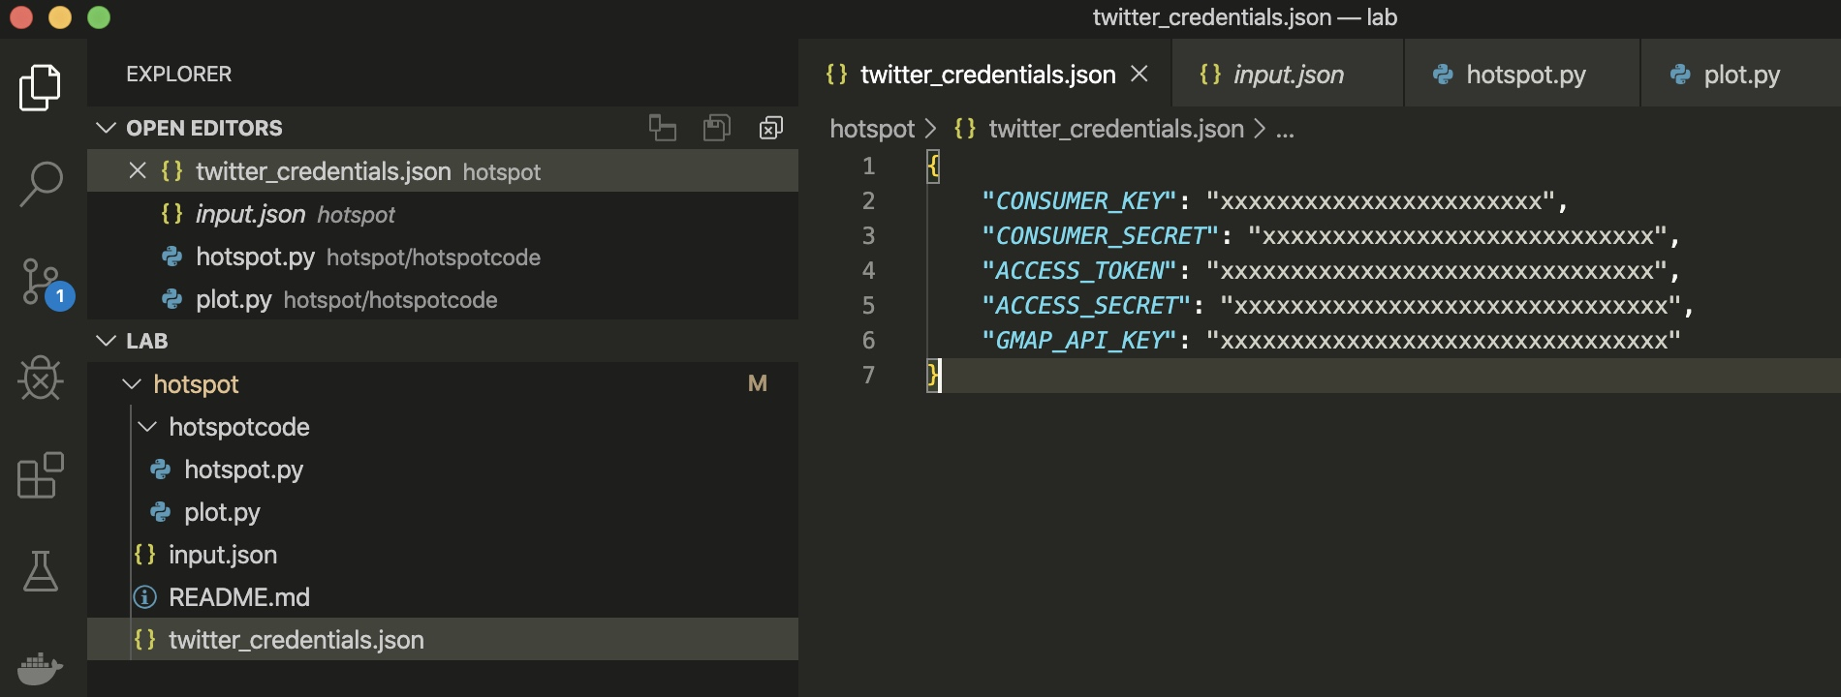
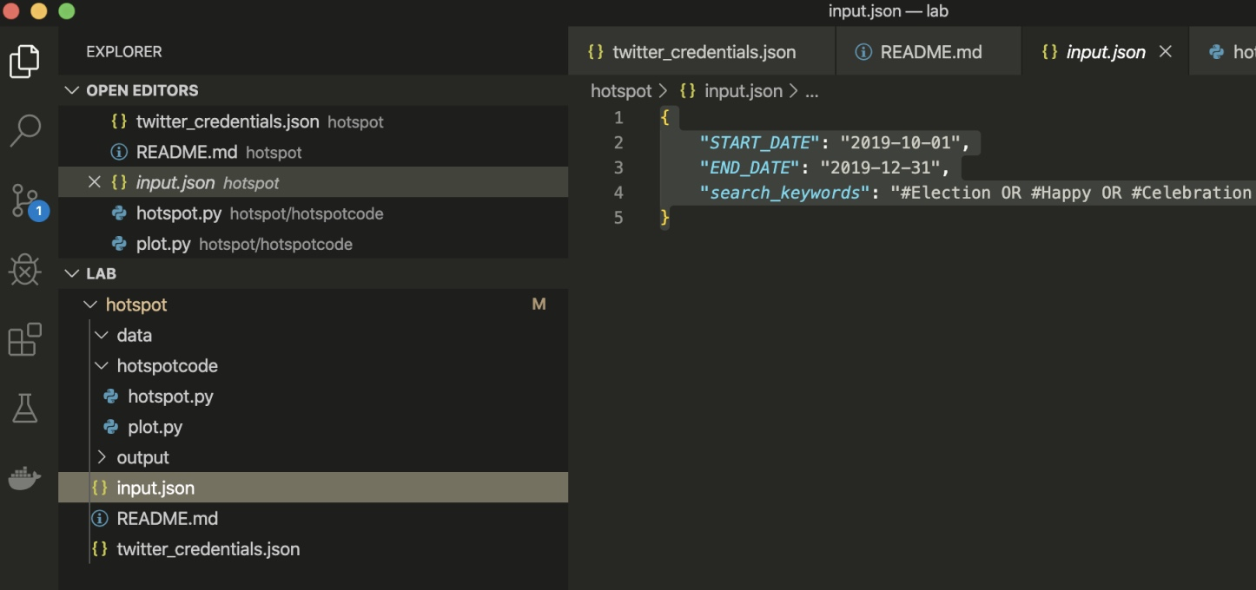
Twitter credentials

Slide 4
Configured inputs

Slide 5
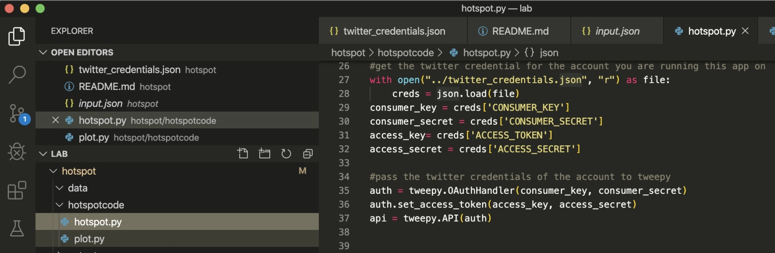
Connecting to twitter

Slide 6
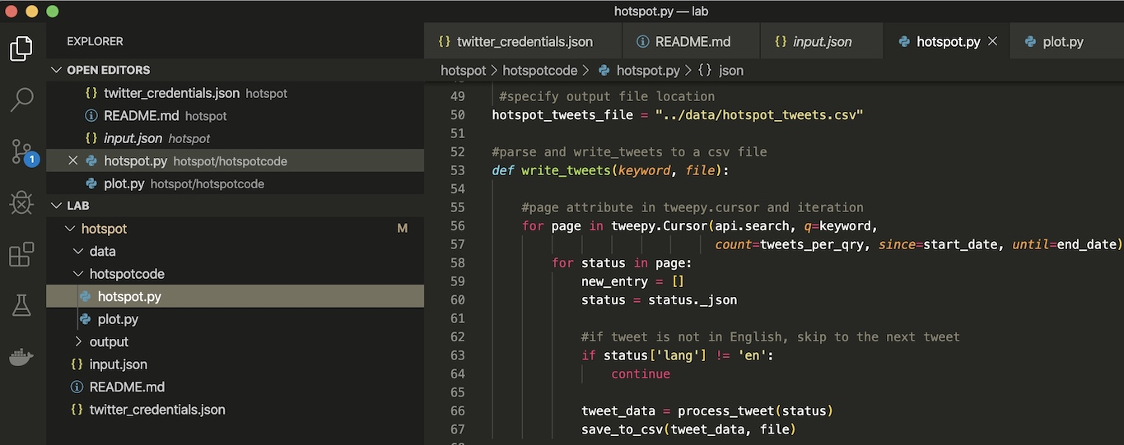
Searching for tweets and save to csv

Slide 7
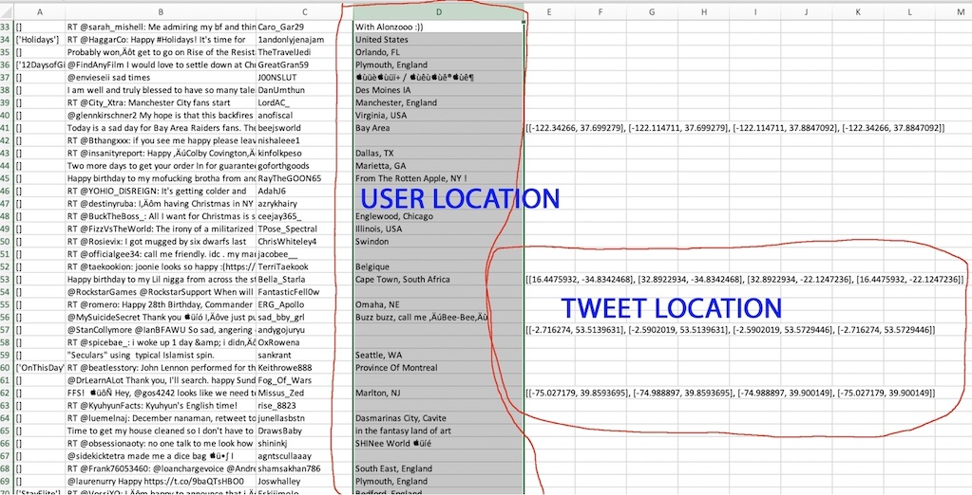
Resulting csv file

Slide 8
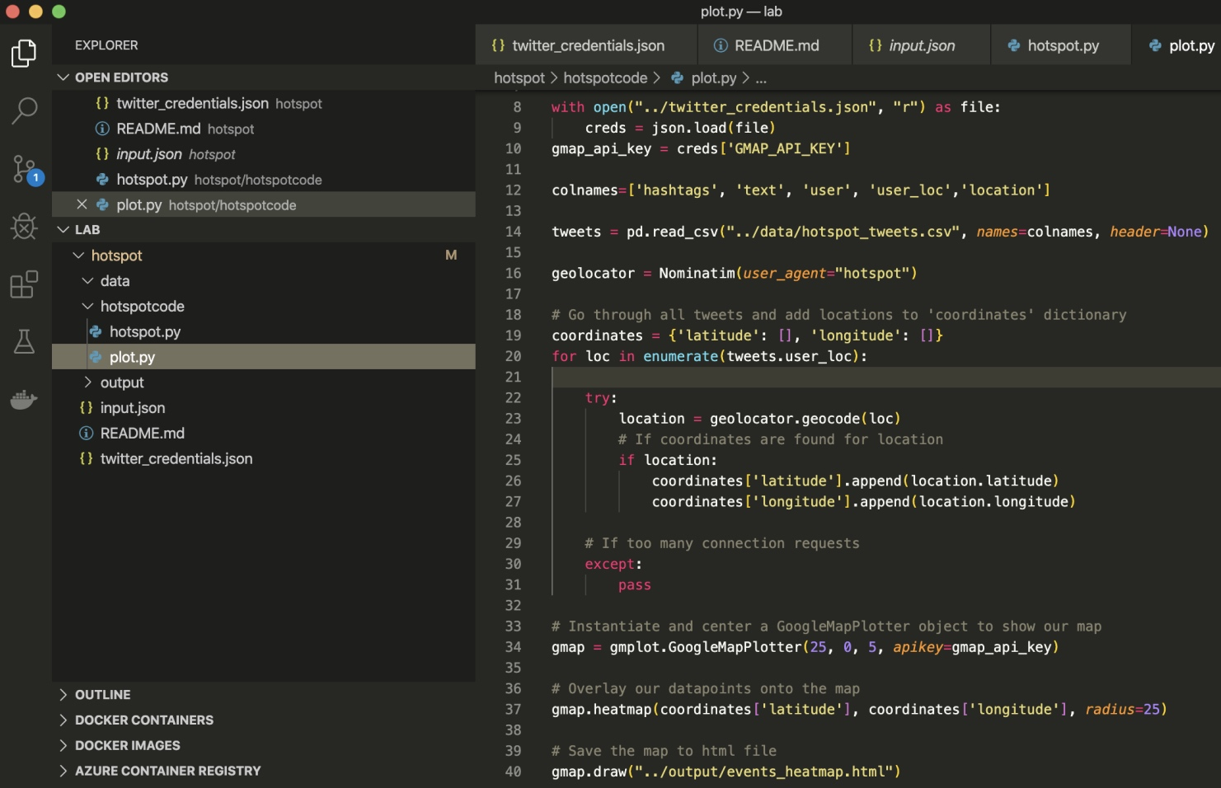
Plot the result as heatmap

Slide 9
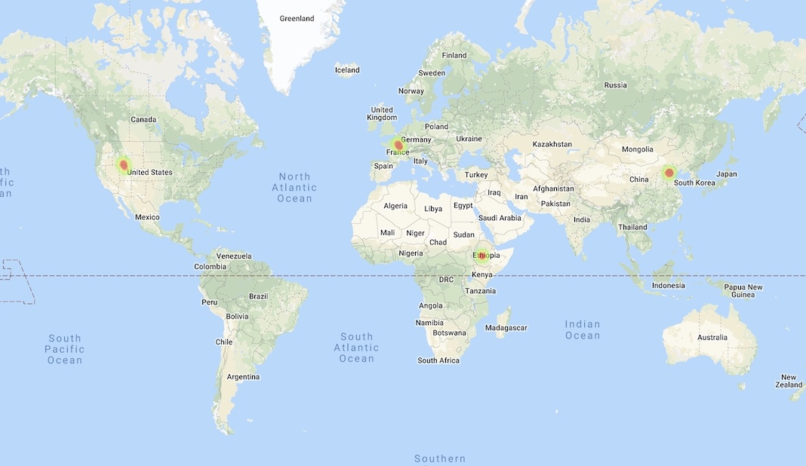
Example hotspots map

Slide 10
Future improvements
As is now, the hotspots are not labeled. So we may not know which spots are what. Therefore, each spot needs to be labeled with a keyword and time frame.
For ease of use, obviously needs to be deployed as a web application with a user interface to input keywords and date range.

